Slide 1
CPIMS hackathon challenge 1
Group 2

Slide 2
Objectives/goals
To develop a Statutory Institution (SI) module in CPIMS to handle below transition steps in these government institutions;
Biodata collection (additional)
Pre-admission
Admission
Stay
Pre-exit

Slide 3
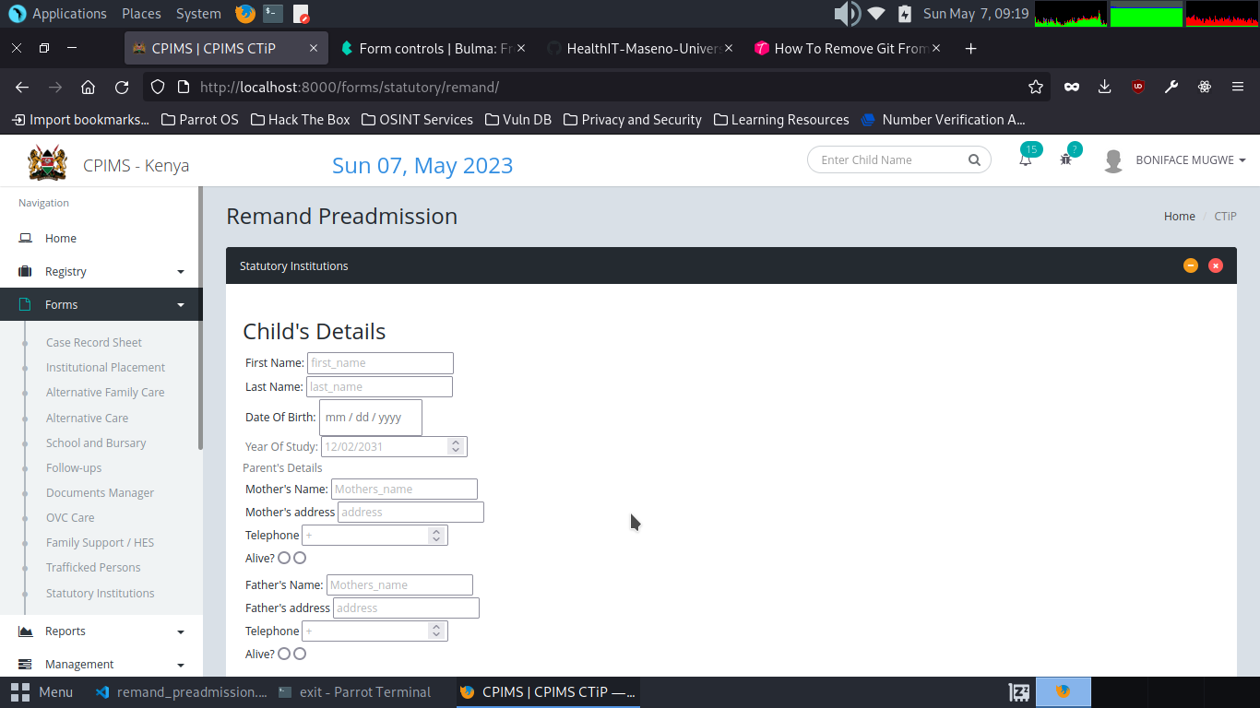
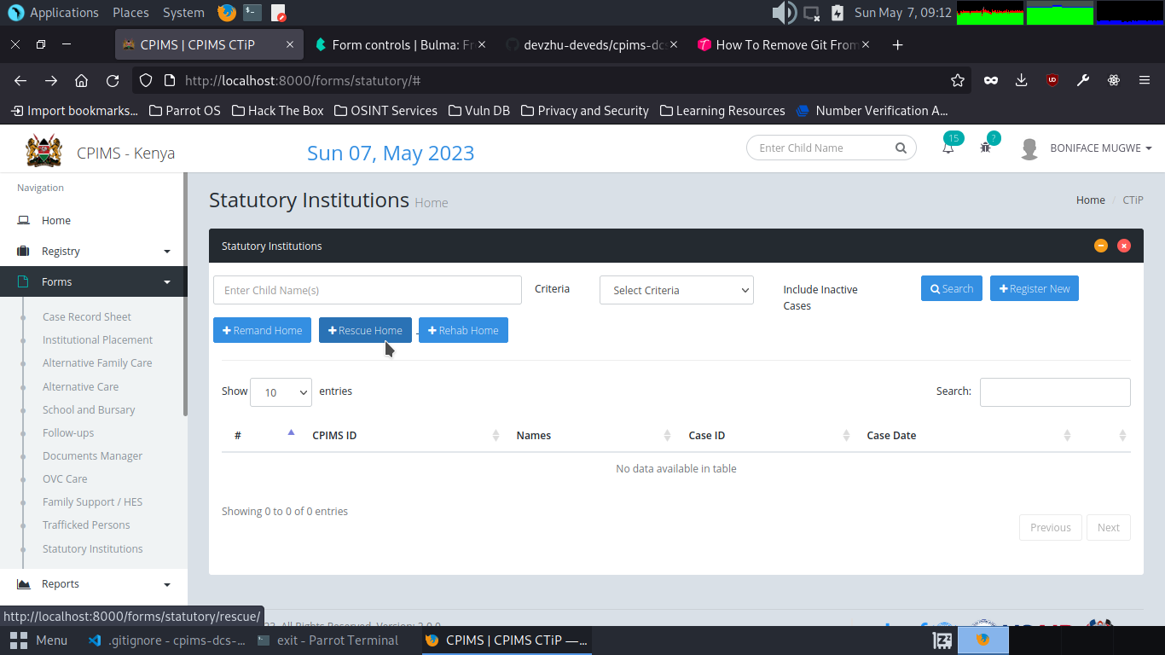
process

Slide 4
Process

Slide 5
Achievements
Managed to re-use Bio-data for the three Statutory Institutions :remand homes, rescue centers and rehabilitation.
Completed the remand homes pre-admission forms.
Ability to work on real-time problems.

Slide 6
Problems encountered
Database Break-down
Zero idea on the proposed programming languages to use.
Getting familiar with CSS Bulma Framework used in the project.

Slide 7
conclusion
We were able to interact with CPIMS and gained knowledge on how real-time applications work and solving their problems.
Given enough time, we would have tackled our allocated task and deliver the desired objectives.
Special thanks to Maseno HealthIT Team.

